Slide 1
AutoRest: The Module Generator
The PoSh Wolf
https://github.com/theposhwolf/sessions

Slide 2
Who is The PoSh Wolf?
Anthony Howell
From Eugene, OR USA so I like to bike, eat granola, and grow out my beard
1 wife, 2 dogs, and 3 descendants
12+ years IT experience
Blogger (https://theposhwolf.com)
Twitter (https://twitter.com/theposhwolf)
Pluralsight author (https://pluralsight.com)
TechSnips contributor (https://techsnips.io)
Consulting (https://howell-it.com)
Employed (https://runway.host)

Slide 3

Eugene, Oregon

Slide 4
I like PowerShell

Slide 5
Definitions
AutoRest
Ingests an OpenAPI definition file and spits out a language specific SDK
Supports: PowerShell, C#, Go, Java, Python, Swift, TypeScript
OpenAPI (f.k.a. Swagger)
A standard specification for defining APIs.

Slide 6
Examples of AutoRest modules
Azure PowerShell Modules: Azure/azure-powershell: Microsoft Azure PowerShell (github.com)
Microsoft Graph PowerShell SDK: microsoftgraph/msgraph-sdk-powershell: Powershell SDK for Microsoft Graph (github.com)

Slide 7
Overview
Brief setup of AutoRest & AutoRest.PowerShell
Overview of a simple OpenAPI file
Including Authentication and basic CRUD
Build a module
Adding Authentication
Adding cmdlets
Using directives for customization

Slide 8
Prerequisites
Node.js
Dotnet SDK 2.2
AutoRest
AutoRest.PowerShell
PowerShell 6+

Slide 9
Demo Environment
Previously mentioned prerequisites
Windows 10
VS Code (latest version)
PowerShell 7.2.2 (should work in Windows PowerShell 5.1)

Slide 10
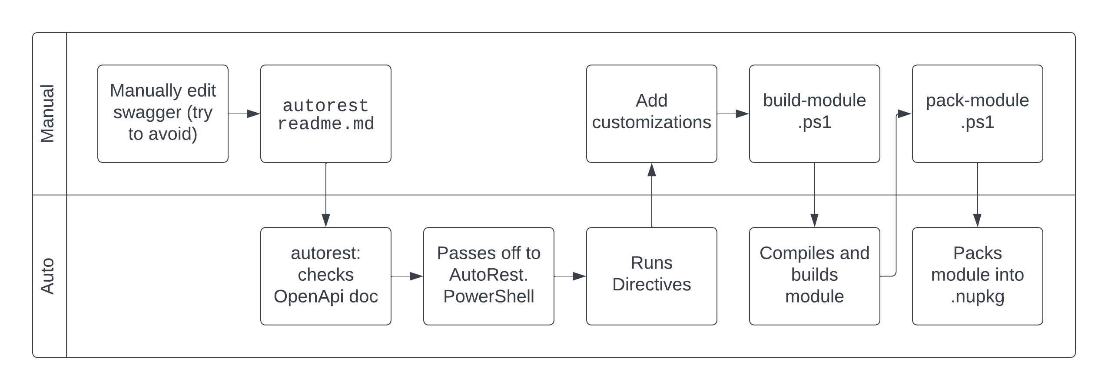
Workflow

